Slide 1

Pokemon
Classifier
Yuet Ho, Tanvir Ahmed, Mir Shahiduzzaman, Abigail Fontana, Ari Markos

Slide 2


Premise
In this hypothetical scenario, we are a team of pokemon researchers in the pokemon world and we want to build a classifier to help identify elemental types for newly discovered pokemons.
Why is a type classifier meaningful for pokemon research?
Pokemon data is discovered in this world
Studying types can be challenging
Notes:
Given we are in the pokemon world, data on pokemon is not given, it is discovered through studying the pokemon.
There are many ways to study different features of pokemon such as their egg cycle by measuring how long it takes for them to hatch, but studying for their types may be more difficult.
Yuet

Slide 3



What are types?
Notes:
First off, what are types? They are just the elements of a pokemon. A charmander is a fire type, a bulbasaur a grass type, a squirtle a water type, etc.
Yuet

Slide 4


Challenges to studying Pokemon types
Typically the most accurate way to figure out a pokemon’s type is by studying their type weaknesses to different attack moves. For example, grass type pokemons are weak to fire type moves.
Ethical concerns
Complaints from advocacy groups
Notes:
This method to studying pokemon types could be ethically problematic as it requires attacking the pokemon with moves that would harm it super effectively.
Pokemon rights activists claim this controversial research method is akin to pokemon abuse and torture.
Using a classifier could help guide researchers to the right direction in deducing a pokemon’s type while also keeping the pokemon in an environment that is safe and healthy.
Yuet

Slide 5
Goals
Using supervised learning with element types as the class labels to train a classifier to predict the type of a test pokemon.
Using a classifier approach could speed up the process of learning a pokemon’s type by predicting what it could be to narrow the amount of thing researchers need to look into.
It could also protect the pokemons being studied by providing an alternative approach to unethical research methods.
Notes:
Mir
We wanted to make a classifier that can predict the type of a Pokemon based on other stats
Using the classifier approach can speed up the process in which we are able to find the type of a Pokemon and this will serve to narrow down how to research
It can also prevent unethical approaches to collect data

Slide 6
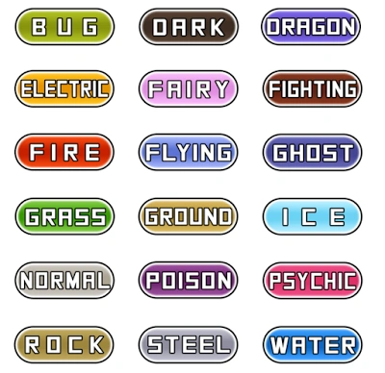
About our dataset
1045 pokemons in total
Some features of a pokemon
Battle stats: Atk, Def, HP, Spd, etc
Egg groups
Types (some can have two elemental types)
Height , Weight
Legendary Status
Species
Abilities
Catch Rate
Growth Rate
Friendship
Notes:
Mir
Battle Stats = the stats of the pokemon
Egg groups = what egg type the egg is (grass, human-like, mineral)
Types = the type of pokemon, which reflects on other attributes such as what it is powerful against, also our target column
Height and weight = the height and weight of each Pokemon
Legendary Status = legendary, normal, mythical
Species = fam the pokemon belongs to
Abilities = What the Pokemon can do
Catch rate = how often Pokemon trainers catch them
Friend = how friendly a pokemon is

Slide 7
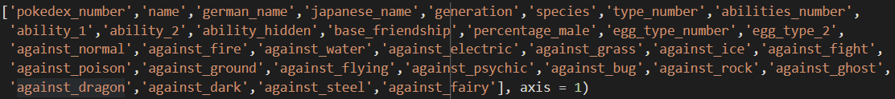
Preprocessing
In order to best use our classifiers, we took out columns we knew for sure to be unrelated to the type:
8th generation pokemons had missing column data. We decided to fill it in the csv, manually with the correct values from online sources as there weren’t too many missing values.
Notes:
Mir
Pokedex_number, name, german, japanese, abilities all unique or too many values
Base Friendship because it was the same for most
Generation doesn’t help bc it shows which game a Pokemon is from, but every pokemon game has a variety of Pokemon, so this was out
Percentage Male b/c several were missing data and we didn’t know if it meant the pokemon was female or non binary
Against stats - it makes it too obvious as to which type the Pokemon is, since Pokemon type gives them a direct advantage against some other types

Slide 8
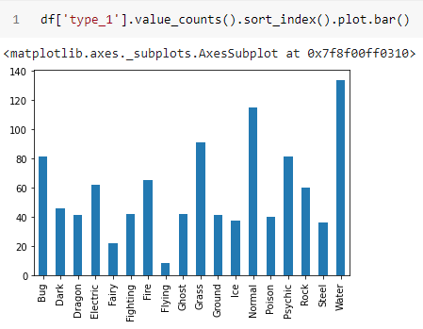
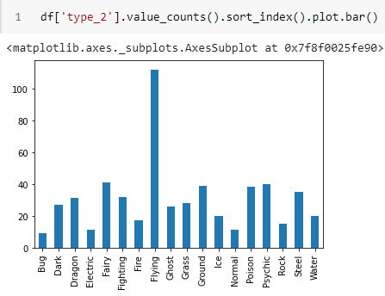
Initial Class distribution for type 1 and type 2
Notes:
Ari

Slide 9

Dealing with Two Target Columns
Problem: 2 columns of class labels, meaning that 1 pokemon could have 2 different types
Solution: train models on 3 different datasets to see which performance is better
Notes:
Abby
So as we just saw, there are two target columns: a type 1 and type 2
Basically what this shows is that a pokemon can have two types, such as flying and also grass
So this was an issue in our dataset because then we have two columns of class labels. This was a problem because 1 pokemon could have two different class labels
Our solution to this problem was to create three different datasets from the original dataset to deal with this problem, and then test each classifier on each different dataset to see which has better performance

Slide 10
6 Data Sets
DF1: Only look at type_1 of pokemon
Removes 1 column (containing secondary type of pokemon)
DF2: Remove all pokemon that have a second type
Removes 552 pokemon
DF3: Duplicate data
This adds 552 pokemon
But this confuses the classifier because there are 2 of the same pokemon (have same stats) but 2 diff class labels
For each of the three datasets, we then created a numerical and categorical version: 3 x 2 = 6
Notes:
Abby
Dataset one looks at just the 1st type of the pokemon. It removes the 2nd target column that has the secondary type of the pokemon. This would make it easier for the classifier since it would just have to classify the pokemon into 1 type instead of 2
Dataset 2 removes all the pokemon that have a second type. About half the pokemon in our dataset had a second type, so our code removed 552 pokemon. This would make it easier for the classifier since it does not have to deal with pokemons with 2 types
Dataset 3 duplicated the data set. So basically instead of having the secondary type of the pokemon in a second target column, it added it into another row, which added 552 more rows of the pokemon who have a second type
This dataset was the most inaccurate since it confuses the classifier since there are 2 rows of the same pokemon with the same stats that could have 2 different class labels
We then made a numerical and categorical version for each of the 3 datasets
And we ultimately ended up with 6 different kinds of datasets

Slide 11
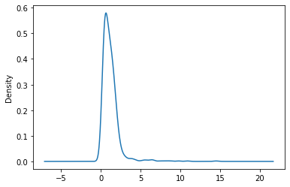
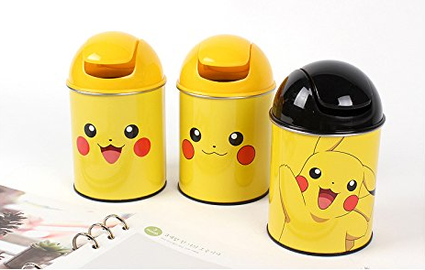
Binning for Categorical
Height, Weight, HP, Attack, Defense, Special Attack, Special Defense, Speed, Total Points, Catch Rate, Base Experience, Egg Cycle
Use equal frequency for most because most were skewed
Replaced outliers with upper bound
Height Frequency Before Outliers Replaced
Notes:
Height before outliers were removed

Slide 12
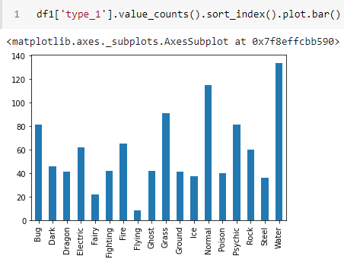
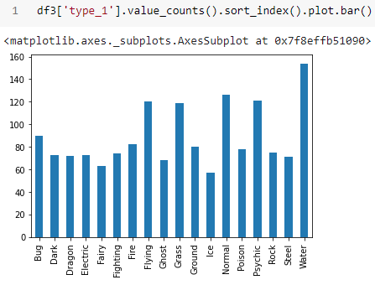
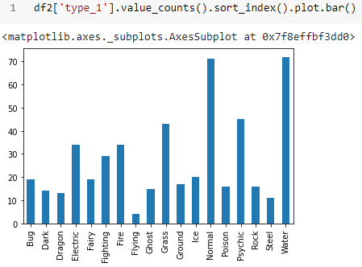
Class distribution of type 1 for the 3 datasets
DF2
DF1
DF3
Notes:
Ari

Slide 13
An
Honorable
Mention...
Notes:
Mir

Slide 14
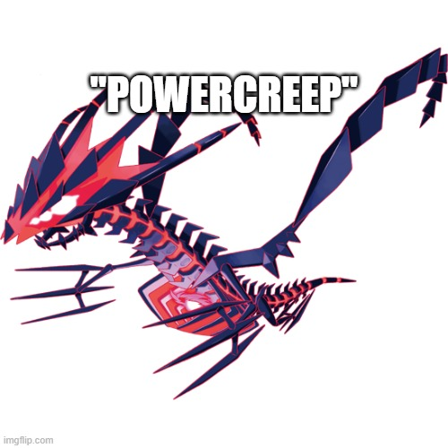
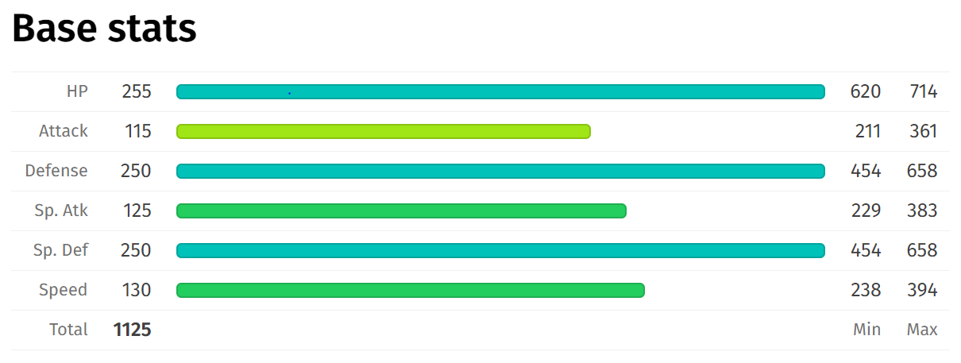
Eternamax Outlier
Notes:
Mir
The only outlier in terms of stats and height Eternatus’ Eternamax form with almost double the total points as the second-highest pokemon and with a whopping height of 100 meters

Slide 15
Assumptions
Every pokemon has the following features:
['status', 'type_1', 'height_m', 'weight_kg', 'total_points', 'hp', 'attack', 'defense', 'sp_attack', 'sp_defense', 'speed', 'catch_rate', 'base_experience', 'growth_rate', 'egg_type_1', 'egg_cycles']
For dataset 1 and 2: Type 1 is the primary type of the pokemon
For dataset 3: Type 1 and 2 are equally important

Slide 16
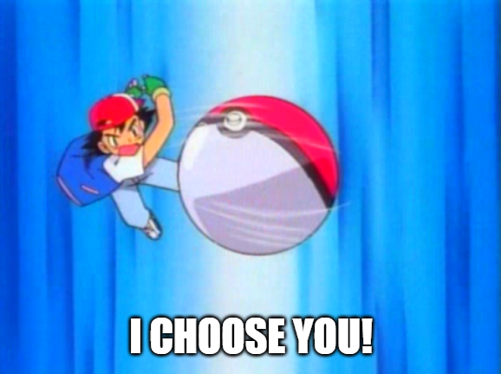
Feature Selection
For each dataset variation, we had to select the best features to use
First, we set up the parameters for cross validation and dataset.
We wanted to optimize the best K for each run of selection.
Next, we ran the feature selection using our K parameter for Chi2 and mutual info, on each of the 6 datasets.
We recorded multiple rounds of feature selected performance results to find the best K.

Slide 17

Results of Accuracy Testing
Dropping class labels (types) made our classifiers more accurate
Dropping the 8 lowest classes gave us the best results without compromising our results too much
Accuracy values for datasets B (categorical) were higher than A (continuous) in general
K values for our feature selection worked best at around 15-25 for most datasets
The top 3 classifiers after initially testing:
BernoulliNB - .52
MultinomialNB - .51
DStree Gini - .47
Notes:
Although different classifiers are more effective on either continuous or categorical data, we found that in general it was more accurate in the B data sets
We decided to used these top three for further optimization and for our ensemble step

Slide 18
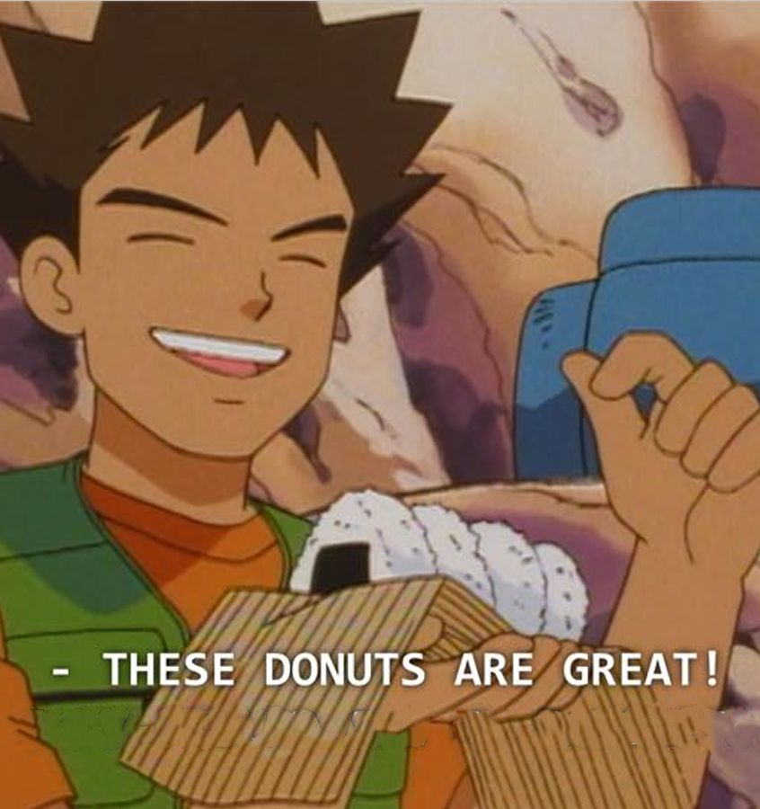
Initial Mistakes
Looking at strongest pokemon instead of the classifying by types
Duplicating the pokemon with 2 types instead of removing them
This became our dataset 3; which had the least accuracy
Notes:
Mir
At first, we wanted to find the strongest pokemon, but then decided that we wouldn’t need a classifier for that since the pokemon’s stats are already given
We previously wanted to duplicate the pokemon w/ two types, but then realized that it would decrease the accuracy of the classifier because there would be two of the same pokemon sometimes

Slide 19
Classifiers
Naive Bayes
Gaussian
Bernoulli
Multinomial
Decision Tree
Entropy
Gini
K-Nearest Neighbors
Notes:
Abby
So since our dataset had a class label, we were doing supervised learning and picked three kinds of classifiers, naive bayes, decision tree, and K nearest neighbors to work on

Slide 20
Naive Bayes

Slide 21
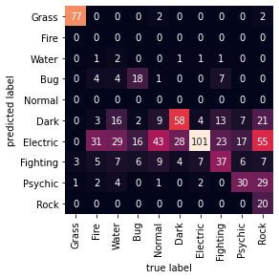
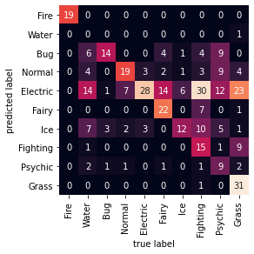
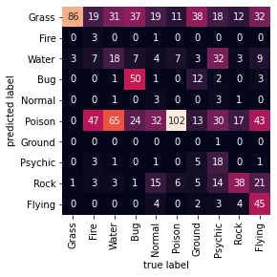
Gaussian
Since this type of classifier is best for continuous data, we used dataset 1a (df1a), dataset 2a (df2a), and dataset 3a (df3a).
Dataset 1a
Dataset 2a
Dataset 3a
K = 19
No Feature Selection -- Accuracy: 0.37 (+/- 0.10)
Chi Square -- Accuracy: 0.42 (+/- 0.15)
Mutual Info -- Accuracy: 0.35 (+/- 0.13)
K = 30
No Feature Selection -- Accuracy: 0.34 (+/- 0.10)
Chi Square -- Accuracy: 0.38 (+/- 0.11)
Mutual Info -- Accuracy: 0.33 (+/- 0.10)
K = 22
No Feature Selection -- Accuracy: 0.29 (+/- 0.10)
Chi Square -- Accuracy: 0.33 (+/- 0.07)
Mutual Info -- Accuracy: 0.29 (+/- 0.13)
Notes:
Tanvir
This was one of the worst in terms of accuracy

Slide 22
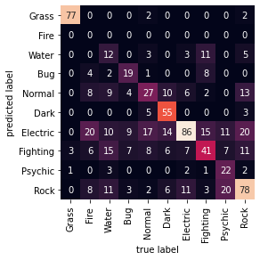
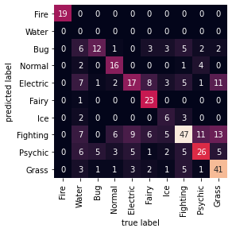
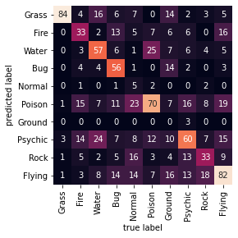
Bernoulli
Since this type of classifier is best for categorical data (binary format), we used dataset 1b (df1b), dataset 2b (df2b), and dataset 3b (df3b).
Dataset 1b
Dataset 2b
Dataset 3b
K = 15
No Feature Selection -- Accuracy: 0.44 (+/- 0.18)
Chi Square -- Accuracy: 0.52 (+/- 0.15)
Mutual Info -- Accuracy: 0.45 (+/- 0.14)
K = 15
No Feature Selection -- Accuracy: 0.35 (+/- 0.16)
Chi Square -- Accuracy: 0.50 (+/- 0.19)
Mutual Info -- Accuracy: 0.45 (+/- 0.14)
K = 15
No Feature Selection -- Accuracy: 0.33 (+/- 0.14)
Chi Square -- Accuracy: 0.44 (+/- 0.14)
Mutual Info -- Accuracy: 0.41 (+/- 0.10)
Notes:
Tanvir

Slide 23
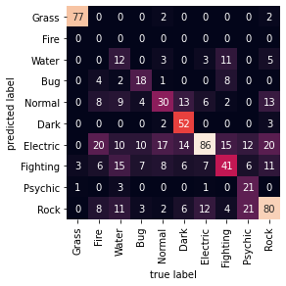
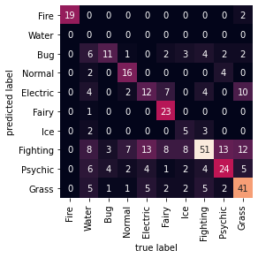

Multinomial
Since this type of classifier is best for categorical data (frequency format), we used dataset 1b (df1b), dataset 2b (df2b), and dataset 3b (df3b).
Dataset 1b
Dataset 2b
Dataset 3b
K = 15
No Feature Selection -- Accuracy: 0.44 (+/- 0.21)
Chi Square -- Accuracy: 0.51 (+/- 0.15)
Mutual Info -- Accuracy: 0.49 (+/- 0.16)
K = 15
No Feature Selection -- Accuracy: 0.33 (+/- 0.18)
Chi Square -- Accuracy: 0.49 (+/- 0.19)
Mutual Info -- Accuracy: 0.45 (+/- 0.15)
K = 15
No Feature Selection -- Accuracy: 0.33 (+/- 0.18)
Chi Square -- Accuracy: 0.44 (+/- 0.19)
Mutual Info -- Accuracy: 0.40 (+/- 0.19)
Notes:
Tanvir

Slide 24
Decision Tree
Notes:
Abby
The second classifier we tried was the decision tree
We built the tree using cross validation with either entropy as the criterion or the default gini

Slide 25
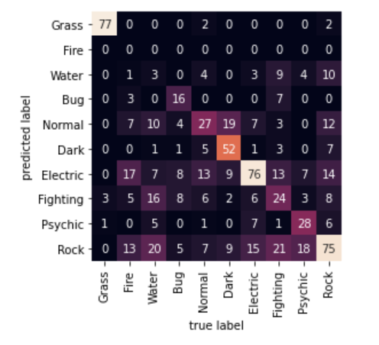
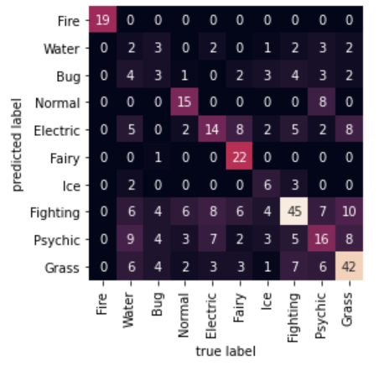
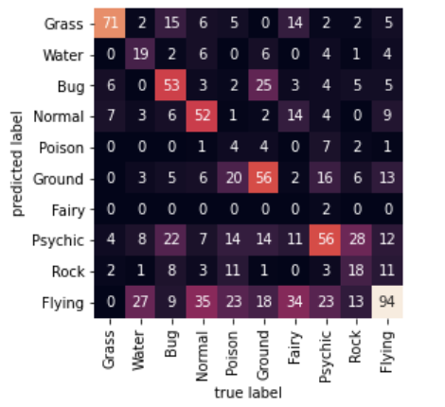
Gini Results
1b 2b 3b
K = 15
Chi Square -- Accuracy: 0.47 (+/- 0.15)
K = 15
Chi Square -- Accuracy: 0.45 (+/- 0.15)
K = 15
Chi Square -- Accuracy: 0.19 (+/- 0.15)
Notes:
Abby
We found that the gini tree had a higher accuracy than building the tree with entropy.
As mentioned before, the B (categorical versions) generally had a higher accuracy than the a
Since we built the tree used sklearn package, we made the categorical data binary and then built the tree using that dataset
1b had an accuracy of .47 which although is low, it was still the most accurate
You can see in the confusion matrix heatmaps that that some of the types that were more accurately labeled are grass and electric
Some of the ones that were less accurate were water and fire

Slide 26
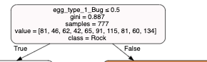
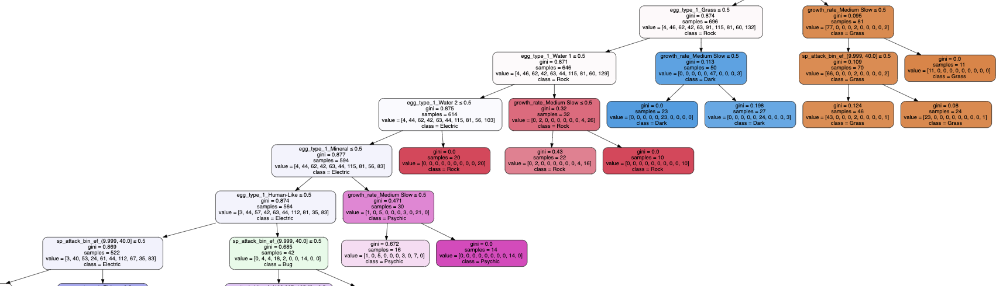
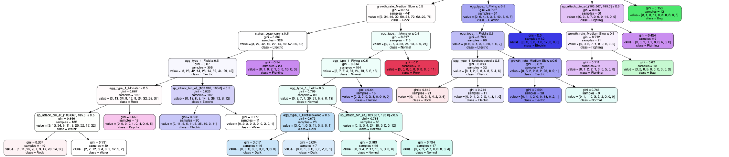
Gini Tree built with cross validation
Notes:
Abby
This is the tree for dataset 1b. After manipulating the parameters, a max_depth of 12 and a min leaf sample of 6 was the most accurate. It was still low with .47 % accuracy using chi squared

Slide 27
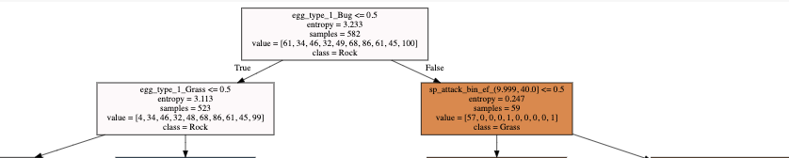
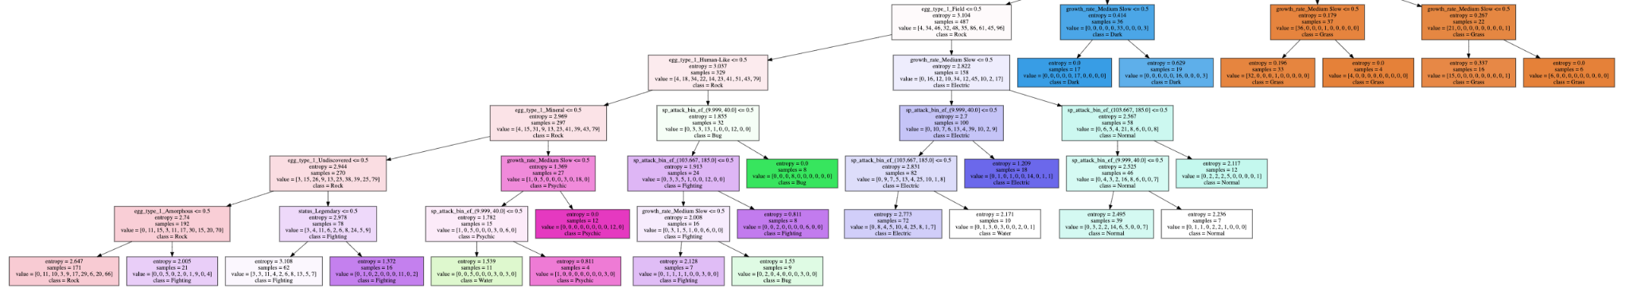
Entropy Tree
Notes:
Abby
This is an example of one of the trees built with entropy for dataset 1b
Although it is easier to visualize with depth of 7 less accurate

Slide 28
K Nearest Neighbors

Slide 29
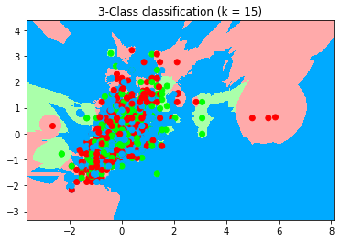
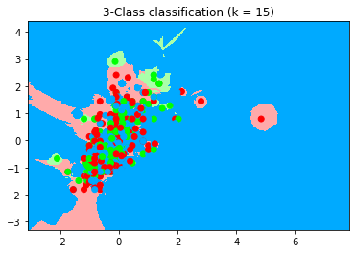
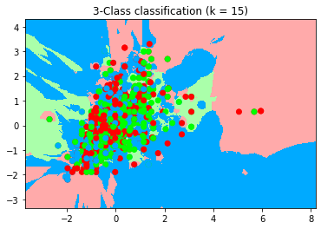
KNN
df1a df2a df3a
Accuracy: 0.3831417624521073
Accuracy: 0.43902439024390244
Accuracy: 0.2581453634085213
Notes:
Ari

Slide 30
Ensemble

Slide 31
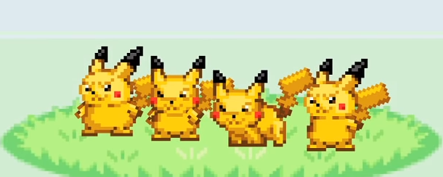
Ensemble
Using bagging and random forest classifiers did not significantly increase the accuracy of our best models.
Ran multiple rounds of ensembling, testing different sample/feature parameter sizes.
Bernoulli NB and Multinomial NB saw a 0.01 increase in accuracy.
Both scored 0.52
Decision Tree Gini saw a 0.04 increase in accuracy.
Gini scored 0.51
Notes:
Yuet

Slide 32
Limitations of Our System
There are 2 columns of class labels
Taking out one takes away from Pokemon’s true types
But keeping both confuses the classifier
There are 18 different class labels
18 different types of Pokemon
Too many for a classifier to handle
Classifier can usually handle max of 10, so we did feature selection
For KNN: doesn’t work well with large datasets
Accuracy for classifiers were altogether low
There was another project which concluded that pokemon stats were not effective for determining types.
Notes:
Abby

Slide 33
Final findings: our available data cannot accurately classify types
The performance scores of our models were simply too low. The highest we ever got was 0.52
Why could this be the case?
We are missing vital information such as appearance, color, etc.
Pokemon stats could vary wildly depending on the evolution state or the different forms that they have (Mega Evolution, Gigantamax, etc)
Limited data points as a result of removing a lot for dataset 1 and 2
Notes:
Tanvir

Slide 34
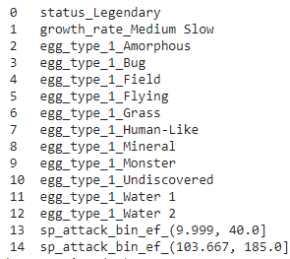
Final findings: Egg type data is favored by the feature selection methods.
Egg type was the most occurring selected feature,
Battle stats were not prominently featured despite the fact they made up the majority of the features.
Notes:
Tanvir

Slide 35
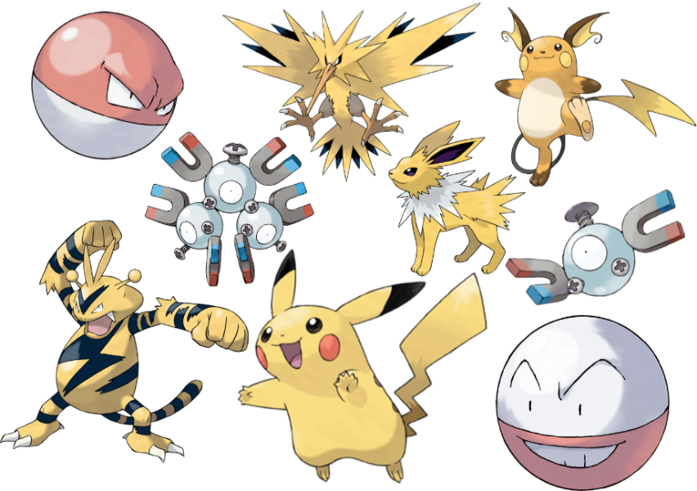
Possible upgrades to the classification model.
We can train image classifiers on pokemon photos.
It is possible that similar types of pokemon tend to have similar physical features. For example, many electric type pokemons are yellow.
Notes:
Mir

Slide 36
Thank You!

